Slide 1
Navigation and Pathfinding
By Carl Miller and Omar Elansary

Slide 2
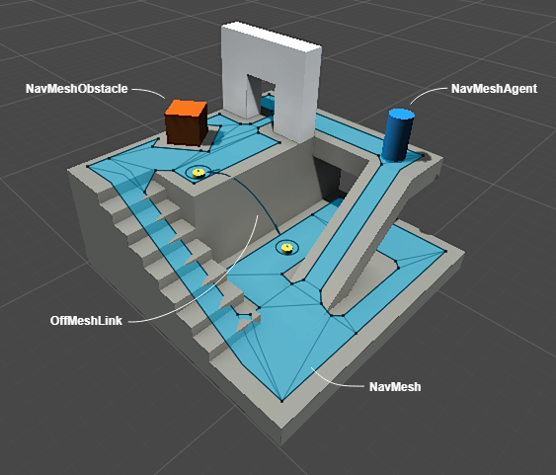
Navigation Mesh Concept
These define what surfaces are walkable by what object you define as the “agent”

Slide 3
How to start
Create an empty object → call it navmesh.
Add component → nav mesh surface (script).
The bake button allows unity to automatically apply the walkable space for you.
You can customize what is caught and not caught by giving certain objects layer tags.
Can do this for render meshes or physics meshes.
We would want to add a layer for the player, as it is the agent that is going to do the pathfinding.

Slide 4
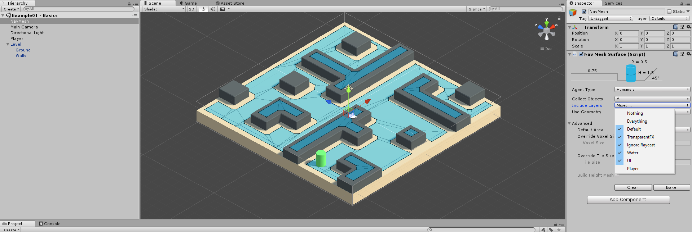
How to start

Slide 5
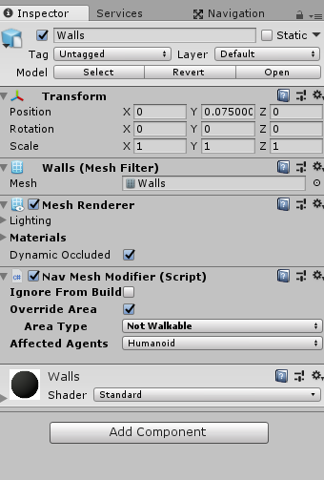
Nav Mesh Modifier
Add Component → Nav mesh modifier → Ignore from build allows you to ignore the object it is attached when applying the global mesh.
Override area has a similar effect, but with more customizable options.

Slide 6
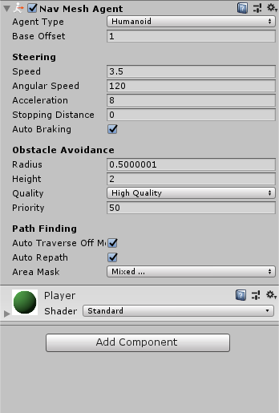
Agent
Can have multiple agents.
These settings are in the “Agent Type” category.
Can change radius, height, slope of each agent type.
Add component → nav mesh agent.
This contains quite a lot of settings to customize how a object is able to navigate a mesh.

Slide 7
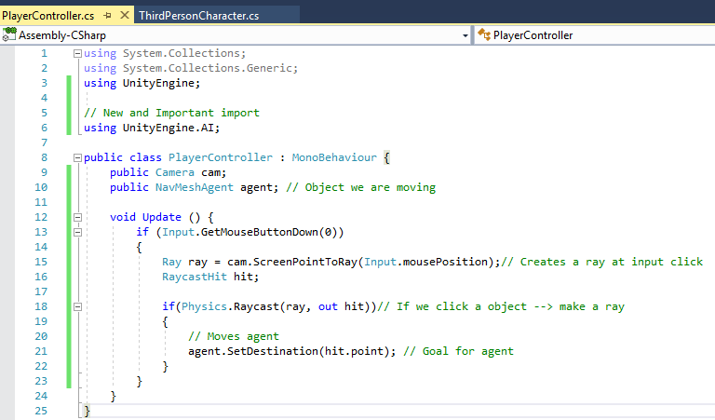
Code
Now that you have all these unity components set up, it is time to code!
The goal of this script is to specify a goal for the nav agent to try and achieve.
Here is an example of a click to move script for a nav agent to follow:

Slide 8
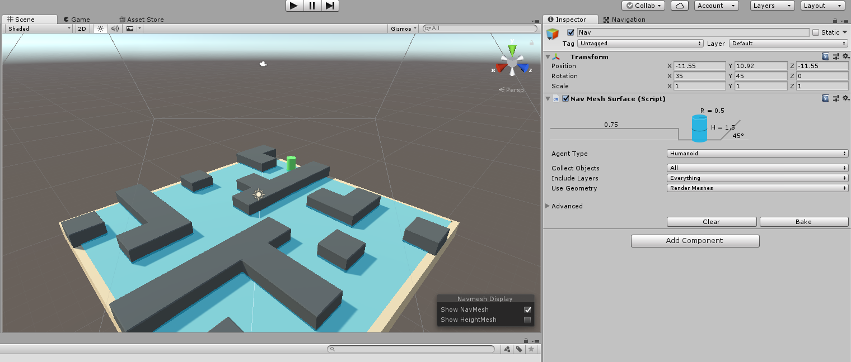
What the game should look like

Slide 9
Nav Mesh: Making it Dynamic
Allows it to update to changes during the game.
Generating a NavMesh at runtime, even without knowing the layout of your level.
Great for creating a NavMesh for procedurally generated levels.

Slide 10
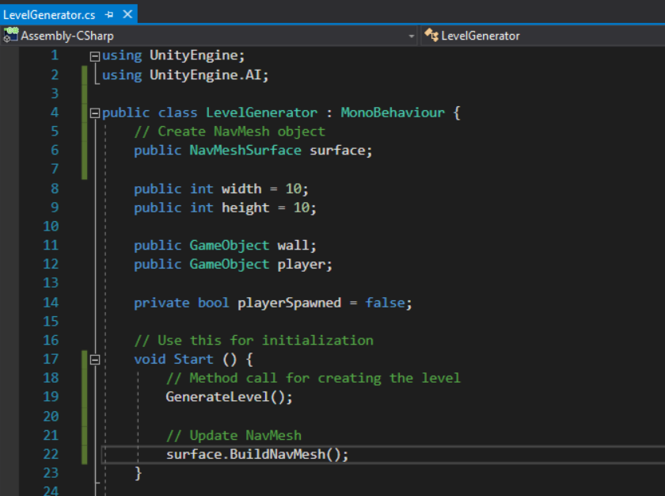
Nav Mesh: Making it Dynamic
Here is some code that is required for updating the NavMesh for a procedurally generated level.
The NavMesh object would
go into the NavMeshSurface field. surface.BuildNavMesh();
allows it to be updated.

Slide 11
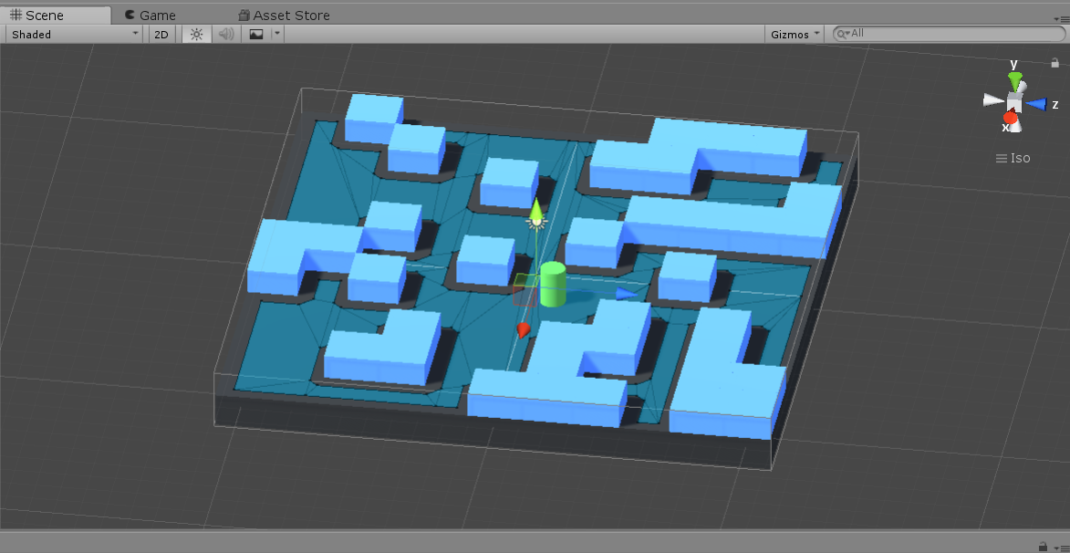
Result

Slide 12
A* Pathfinding Project
Website: https://arongranberg.com/astar/
Free version available.
Saves time creating AI scripts.
Uses the efficient A* Search.

Slide 13

A* Demo

Slide 14
Comparison
Unity Standard
A* Pathfinding Project
Pros:
Easy to use and setup.
Built into unity itself.
More support online.
Cons:
Doesn’t scale well.
Need a lot of code.
Pros:
Saves time creating scripts.
Allows for complex interactions.
Allows for easy customization of scripts.
Cons:
Complex.

Slide 15
Work Cited
Special thanks to these youtubers:
Brackeys (Unity hired him to make tutorials): https://www.youtube.com/channel/UCYbK_tjZ2OrIZFBvU6CCMiA
Aron G (Creator of A* Pathfinding Project): https://www.youtube.com/channel/UCGFisjWwbaA5JZXDOoOMjJg

Slide 16
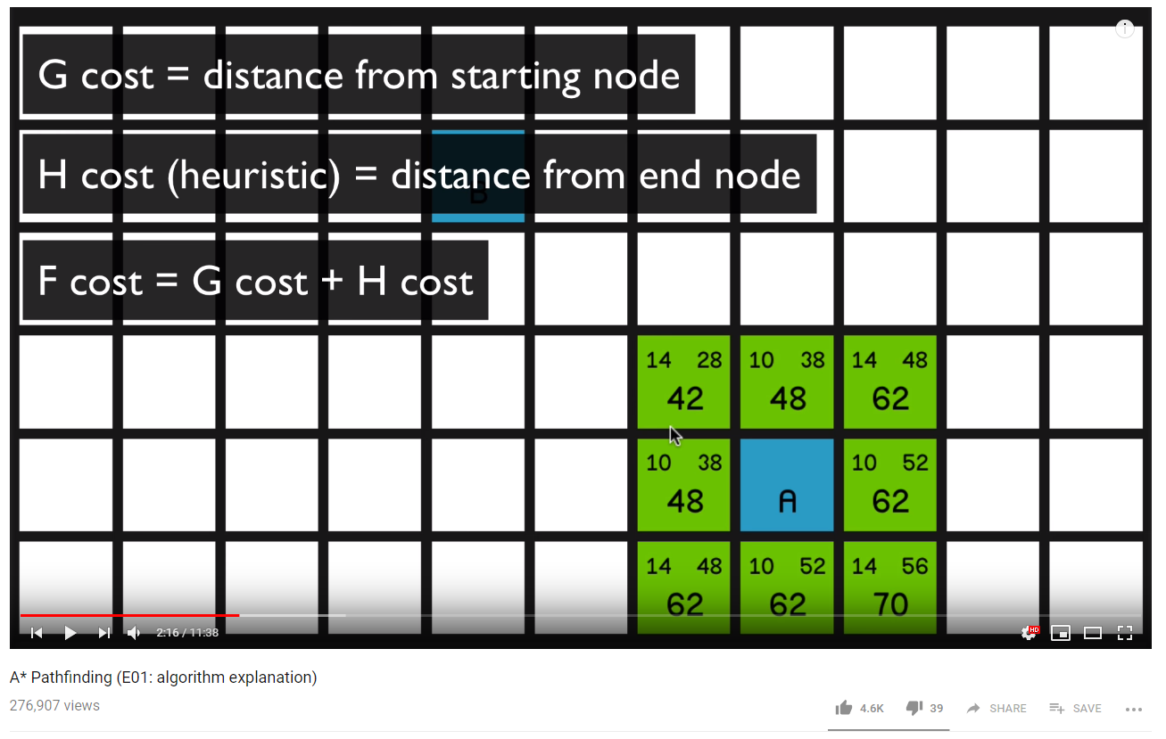
Work Cited
Sebastian Lague (Amazing video on math behind A* and pathfinding):
https://www.youtube.com/watch?v=-L-WgKMFuhE&list=PLFt_AvWsXl0cq5Umv3pMC9SPnKjfp9eGW

